Slide 1
CARE HAVEN
Mridul Kanti
2025

Slide 2
ABSTRACT
Roles & Functions: Two main roles: User and Admin, each with distinct functionalities.
User Capabilities: Users can browse orphanages, make direct donations, share feedback, and delete feedback for control over contributions.
Admin Responsibilities: Admins manage orphanage profiles, donation records, and monitor user feedback to enhance community engagement.
System Purpose: A web-based system aimed at improving management and collaboration between users and orphanages.
Continuous Improvement: Feedback from users supports continuous improvement of orphanage operations.

Slide 3
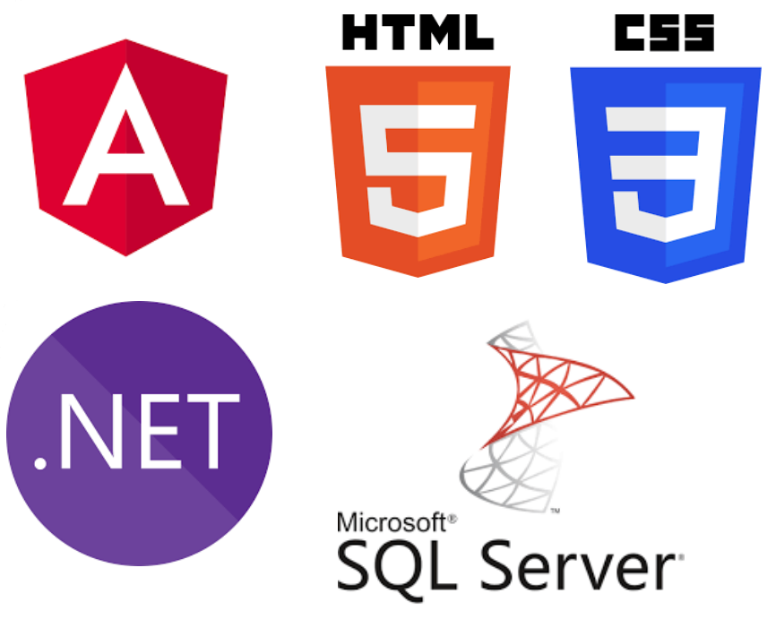
SOFTWARE REQUIREMENTS
Operating system : Windows 10/11.
Coding Language : C#.net,
Frontend : ASP.Net Core, WEB API, HTML, CSS, JavaScript, JQuery, Angular 17
IDE Tool : Visual Studio code ,Visual Studio .Net, PostMan/ Webstorm
Database : SQL SERVER 2019.

Slide 4
MODULES LIST AND DESCRIPTION
Donation Module
User Interaction Module
Admin Management Module
Purpose: Handles the donation process, including payment management and history tracking.
Features:
Donation Process: Enable users to donate to specific orphanages .
Donation Records: Maintain a transaction history for users and admin tracking.
Receipt Generation: Generate digital receipts for completed donations.
Purpose: Allows users to view details, access records, and interact with the system seamlessly.
Features:
User Dashboard: Overview of user activity (e.g., donations made, orphanages viewed).
View Orphanage Details: Explore orphanages, filter by active/inactive status.
My Donations: View donation history with details like orphanage name, amount, and date.
Feedback: Submit and view feedback entries.
Purpose: Enables the admin to manage the system efficiently, including overseeing orphanages, donations, and feedback.
Features:
Dashboard: Admin overview of key metrics (e.g., total donations, active orphanages, user activity).
Orphanage Management: Create, View, Update, and Delete orphanage records.
Donation Management: View and track donations made by users.
Feedback Management: View feedback provided by users for transparency.

Slide 5
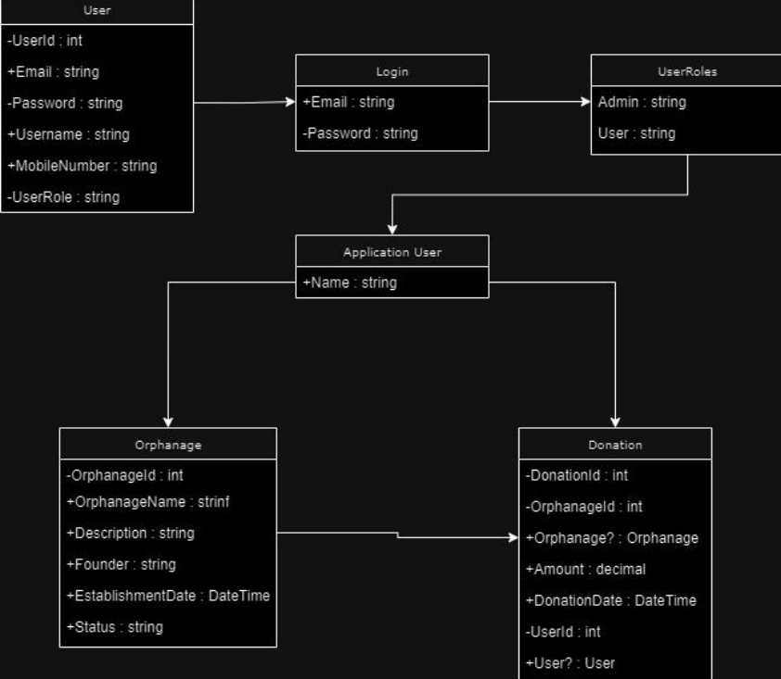
CLASS DIAGRAM (Whole project)

Slide 6
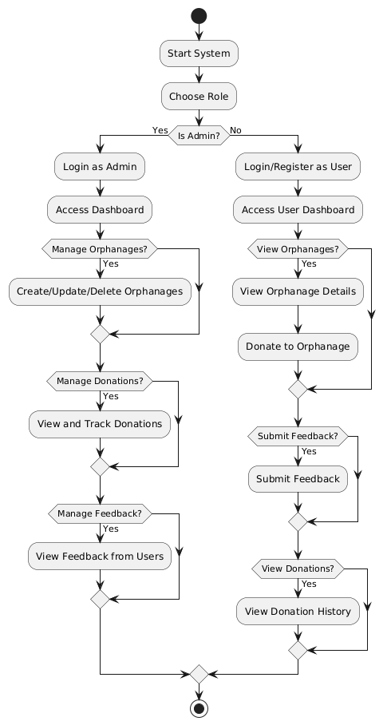
ACTIVITY DIAGRAM (Whole project)

Slide 7
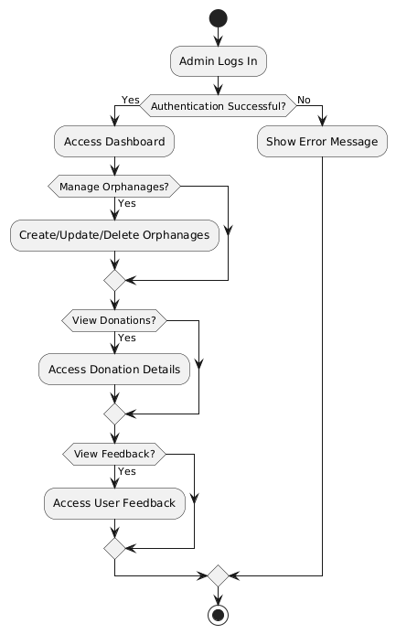
ADMIN MODULE ACTIVITY DIAGRAM

Slide 8
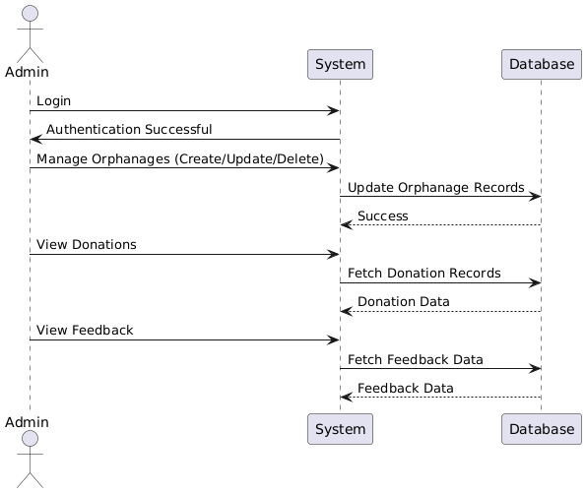
ADMIN MODULE SEQUENCE DIAGRAM

Slide 9
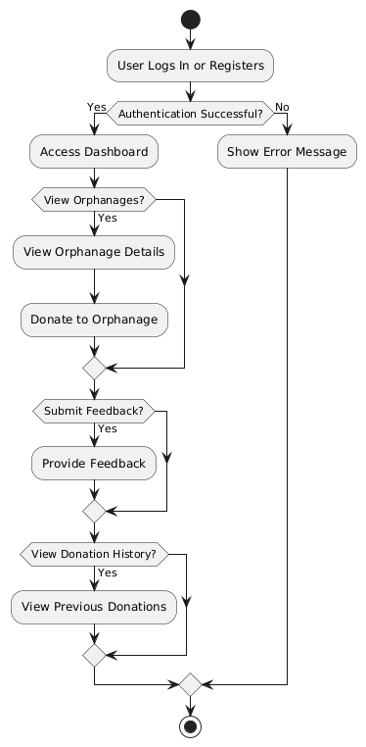
USER MODULE ACTIVITY DIAGRAM

Slide 10
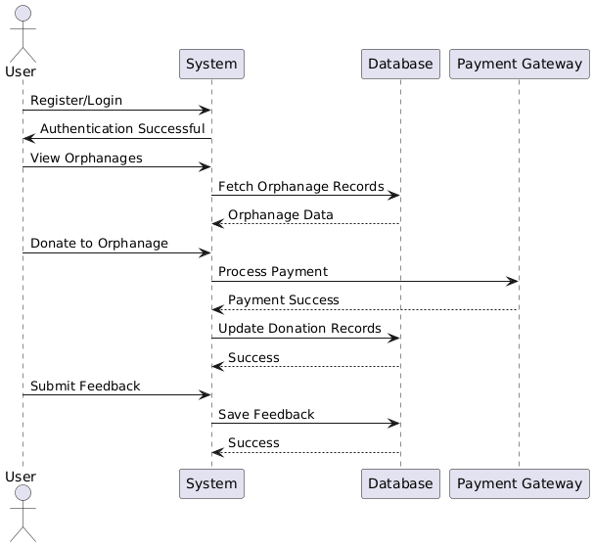
USER MODULE SEQUENCE DIAGRAM

Slide 11
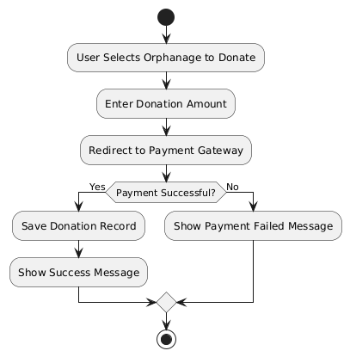
DONATION MODULE ACTIVITY DIAGRAM

Slide 12
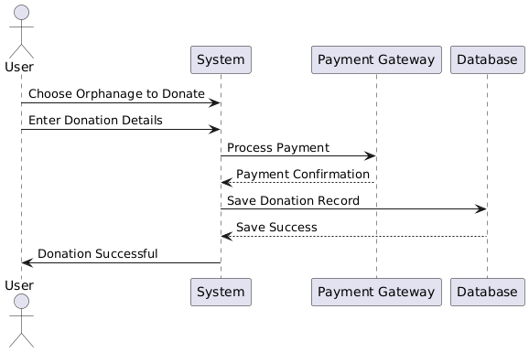
DONATION MODULE SEQUENCE DIAGRAM

Slide 13
FUNTIONALITIES
Donation
User Interaction
Admin Management
User can access the orphanage details and check Active and Inactive Orphanages and Donate to that Orphanage.
User can access own donation details and access the whole orphanage details
The user can either register or log in to the system.
User can add feedback that can be accessed through the both Admin and User View Feedback Page.
User can navigate to Home, Orphanage, My Donations, and Feedback sections.
Users can view their donation history.
Admin can access the orphanage details and perform Edit, Delete and Check the Donations by User with the search functionality.
Using this page Admin can add Orphanages to the system that can be accessed by the user.
Admin can access the orphanage donations made by users.

Slide 14
THANK YOU

